Slide 1
Canada Broker Connectivity
Onboarding Presentation
1st August 2018

Slide 2

Agenda
Project Overview
Business Problem
Project Objectives & Benefits
Project Scope Overview
High Level Architecture Overview
Key Deliverables
Project Approach
Team Structure
Current Relayware Solution
Project Scope & Sprint Plan
Scope for 1 Month UX Engagement
Working Practices/Process
Business Availability
Next Steps

Slide 3
Business Problem
Most leading insurance carriers have a Broker portal to conduct Policy Changes. Pembridge does not have a Broker portal.
Pembridge wishes to create a user-friendly portal for their Brokers.
Connect with Brokers how they want to connect.

Slide 4
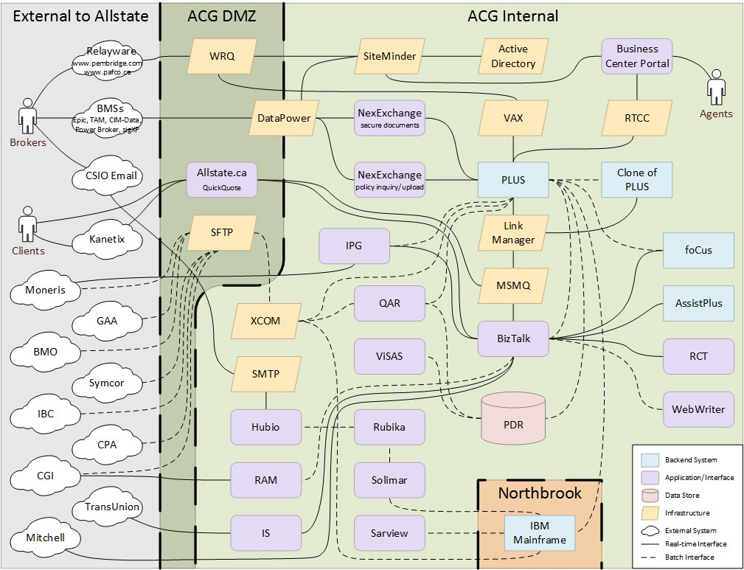
Business Problem - Current State is Complex
4

Slide 5
Project Objectives & Benefits
Objective | Benefit
Make it easier for Brokers to do business with Pembridge | Support Pembridge growth
Reduce number of transactions Pembridge enters on behalf of brokers | Drive efficiencies for the Business and support Pembridge profitability
Industry Catch Up | Maintain brand standing in the industry
Create reusable services as part of a longer term connectivity vision | Offer flexibility for future integration with PLUS

Slide 6
Project Approach - Phases
The project will be delivered in three main phases:
Phase 0 Ramp Up Phase to determine project scope and delivery approach, secure resources and provision development infrastructure
Phase 1 Development of required portal functionality to reach a Minimal Marketable Product (MMP)
Phase 2 Additional portal functionality required by the business

Slide 7
Project Scope Overview
Phase 1 is to deliver the following functionality by brokers on our primary lines of business for both Pembridge and PAFCO in all Provinces except Quebec
Line of Business | Functionality
Automobile Private Passenger | Change Customer Information, e.g. Name, Address, contact details, etc. Add, Change, Delete: - Coverage information - Operator information - Vehicle information - Discounts
Property Comprehensive HO Broad HO Standard HO Comprehensive Condo Named Peril Condo Comprehensive Tenant Named Perils Tenant | Change Customer Information, e.g. Name, Address, contact details, etc. Change Coverages and Location Add, Change, Delete - Mortgagee / Interested Party - Coverages - Additional Coverages - Personal Article floaters - Discounts

Slide 8
Project Scope Cont.
Phase 2 is to deliver the following functionality by brokers on our primary lines of business for both Pembridge and PAFCO in all Provinces except Quebec
Line of Business | Functionality
Automobile ATV Snowmobile Utility Trailer Motorhome Camper Trailer Motorcycle | Change Customer Information, e.g. Name, Address, contact details, etc. Add, Change, Delete: - Coverage information - Operator information - Vehicle information - Discounts
Property Mobile HO Residential Fire Secondary HO Boat Seasonal HO | Change Customer Information, e.g. Name, Address, contact details, etc. Change Coverages and Location Add, Change, Delete - Mortgagee / Interested Party - Coverages - Additional Coverages - Personal Article floaters - Discounts

Slide 9
High Level Architectural Overview

Slide 10
Project Deliverables
The project has four main deliverables:
Broker Portal Delivered through a CMS
Set of Services Allows the portal to interact with PLUS
policy system
PLUS Updates To enable interaction with the Services
Security Components

Slide 11
Project Approach - Methodology
Development Methodology – Agile Scrum
Why Agile?
Business see demos of working code at the end of each sprint
Development team obtains regular feedback from the business
No surprises for the business at the end of the project
Functionality planned for the product can be changed quickly to reflect evolving business priorities
The Agile team has regular opportunities to reflect on its effectiveness and make improvements
Integration testing is carried during each sprint and is not left until after unit development has completed

Slide 12


Project Approach - Scrum Cycle
Sprint Retrospective
Product Vision
Backlog Refinement
Daily Scrum
Ready
Sprint
(Time-boxed 1-4 Weeks)
Sprint Planning
Sprint Review
Done
Product Backlog
Sprint Backlog
Potentially Shippable Increment

Slide 13
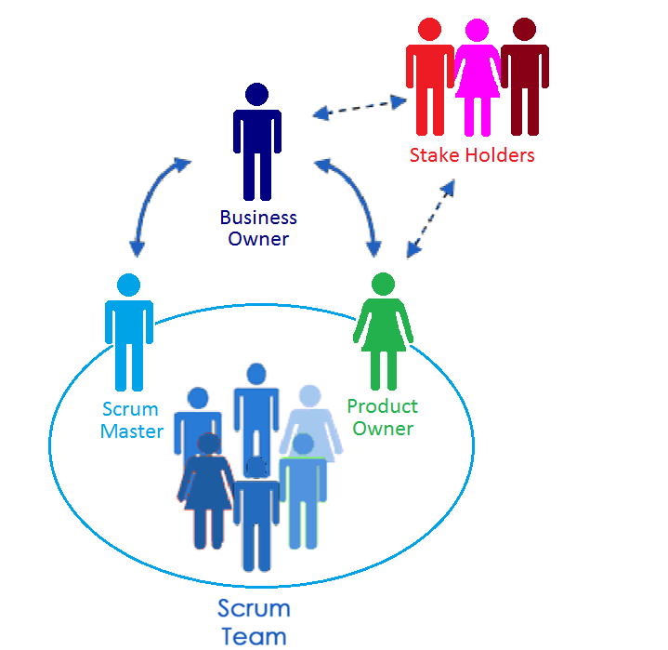

Project Approach - Agile Roles
Agile Coach
Development Team

Slide 14
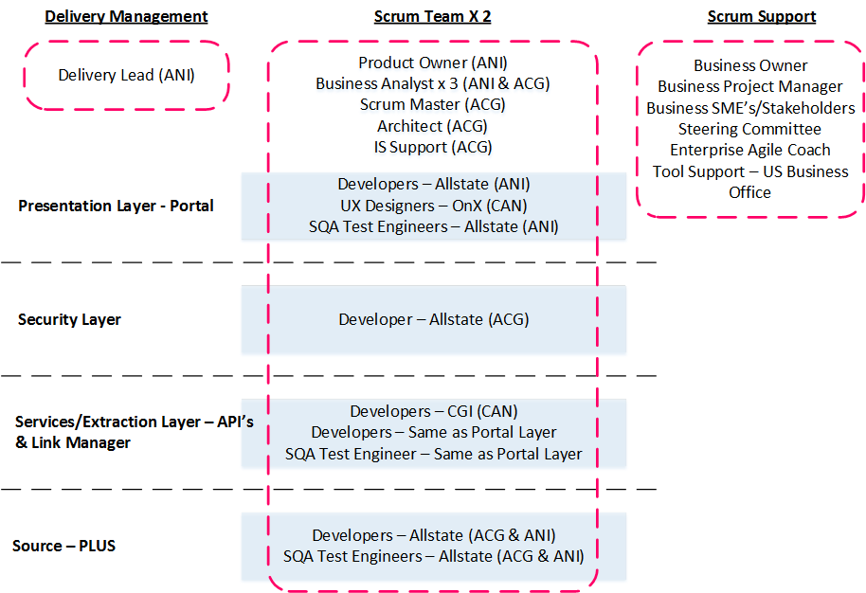
Team Structure

Slide 15
Roles & Responsibilities
 | Project Role | Team Member
Own | Business Sponsor | Bob Tisdale - President, Pembridge / Pafco
 | IT Sponsor | Janine Leahey - VP and CIO, IT
 | Business Owner | Neal Muschet - Director, Strategic Initiatives
 | IT Owner | Luke Mellors - Director, Application Service
Define | Business Owner | Neal Muschett - Director, Strategic Initiatives
 | Business Lead | Julia Rodgers
 | Product Owner | Lisa Ross
 | Business Analyst | Darren McMenamin Atul Sharma Yvonne Tsuchiya

Slide 16
Roles & Responsibilities
Define | SMEs | Scott Campbell Jean Gauvreau Jennifer Power Michele Boule Shuna Wilson - Business Broker Processes Peter Thoma - Business Broker Connectivity Internal Operations Tina Head - Owner of Pembridge.com and Relayware relationship Sarah Manley - Pembridge.com Co-Ordinator

Slide 17
Roles & Responsibilities Cont.
Deliver | Delivery Manager | Carolyn Johnston
 | Business Project Manager | Annette Winters
 | Scrum Master - Management | Murali Gnanasekeram
 | Scrum Master - Technical | Conor McCormick
 | Application Architect | Dennis Manchak
 | UX Designer | TBC
 | Allstate Developers | Paul McCorry Michael Finlay Elaine O’Donnell Martin Van Dyk Bojana Perisic Mohdazharuddin Ansari Dave McAdam Sachin Pol
 | CGI Developers | TBC
 | SQA | Susan Wake Barry Gracey Neil Carey TBC – ANI Recruit
 | Application Support Infrastructure Support | Peter Chow Vinny Singh
Support | ACG Vendor Relationship Manager | Stu Boasman
 | CGI Account Manager | Kevin Caroll

Slide 18
Scope & Sprint Review
Project Scope Review
Sprint Plan Review

Slide 19
Onboarding Plans
Personalized onboarding plan review

Slide 20
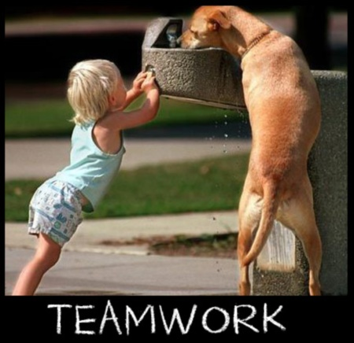
Wrap Up
“If everyone is moving forward together, then success takes care of itself” Henry Ford

Slide 21

Questions?

Slide 22

Appendix
Appendix – Not Planning on using anything past this point!

Slide 23
Current Pembridge.com
Pembridge.com is built using Relayware CMS
https://www.pembridge.com/

Slide 24
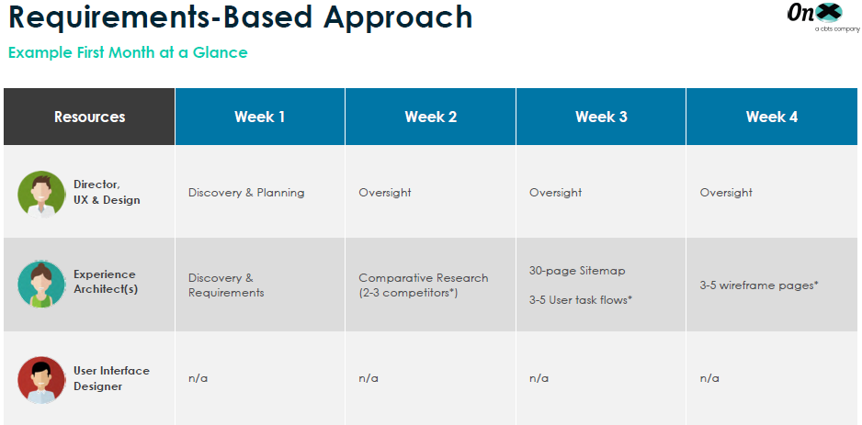
UX Scope – Initial 1 Month

Slide 25
UX Scope – Initial 1 Month Cont.
Working Practices/Processes
Business Availability
Next Steps

Slide 26
Project Scope – Out Of Scope
Line of Business | Functionality Not Offered in Phase 1 or Phase 2
For all Automobile & Property | No functionality offered to Quebec Brokers Cancellations Reinstatements Claims French Broker Portal English and French Underwriter Portal

Slide 27
Achievements To Date
CGI POC – successfully complete
Team Structure Defined - resource hiring in progress
Architecture - Solution Design draft complete
Scope - Identification of feature set for Phase 1
Charter authoring in progress
Security compliance alignment in progress
Standing up toolsets – Jira, Replicon
‘Sprint 0’ underway
Agile training planned

Slide 28
Next Steps
Review & Sign Off Charter
Review & Sign Off Solution Architecture Design
Finalize prioritized feature set and MMP (Phase 1)
API Structure
Portal Screen Structure
Estimate
Train team members on agile
Define Scrum SDLC
Features roadmap
Build product backlog

Slide 29
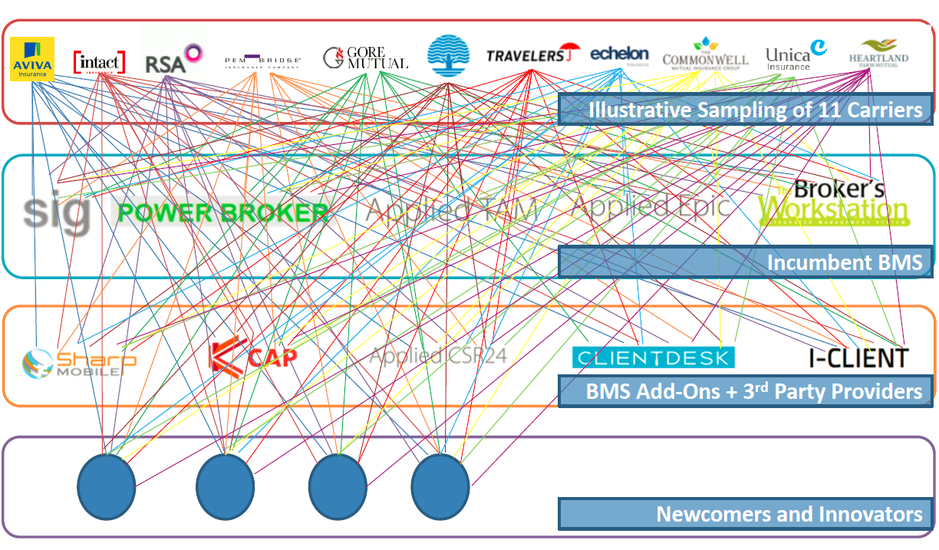
Business Problem - Equally Complicated for Brokers

Slide 30
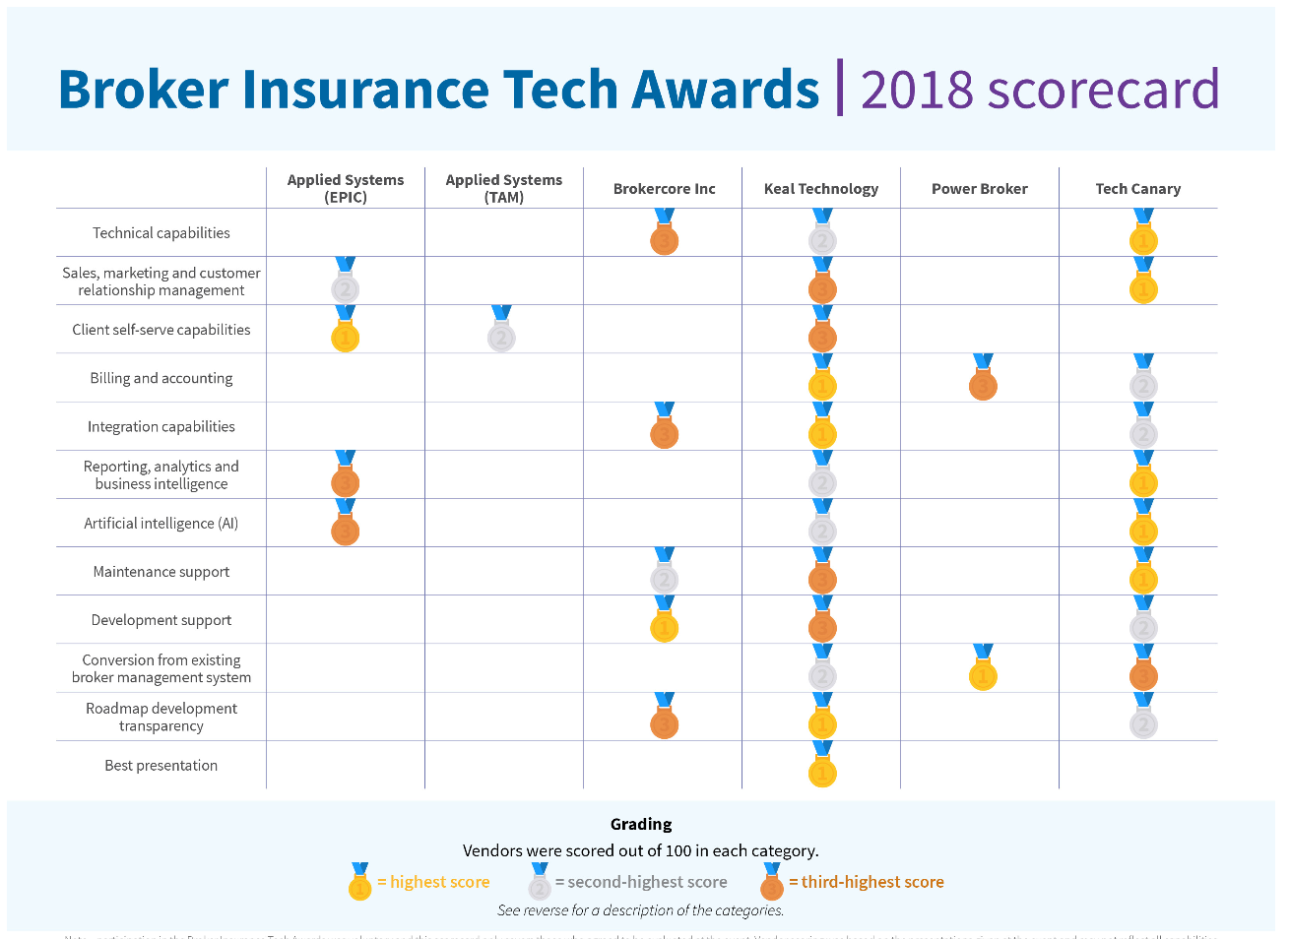
Business Problem - Even the BMS’ are at Different Stages

